Slide 1
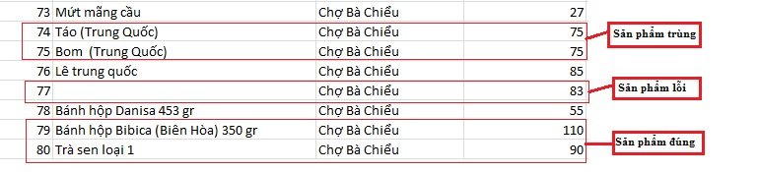
Data Source
Excel files.
Data mining from websites.

Slide 2
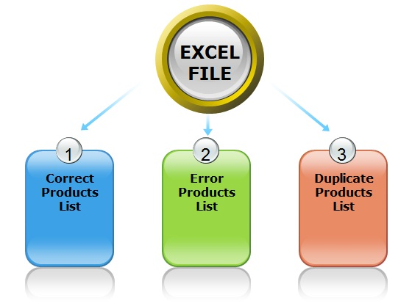
Excel Flow

Slide 3
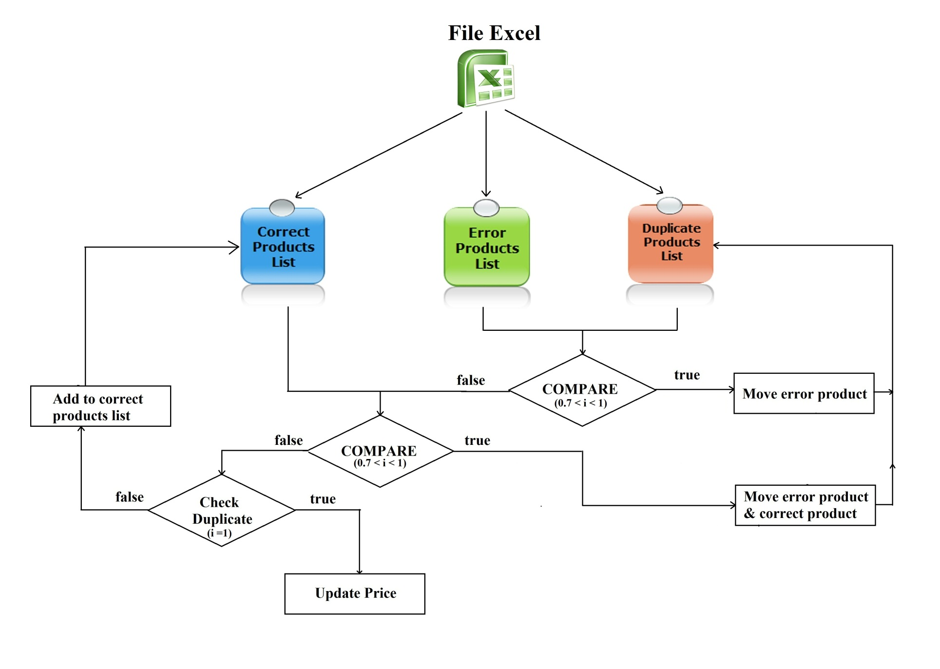
Excel Flow

Slide 4
Excel Flow
Step 1: Import Excel.
Step 2: Process error products & duplicate products.
Step 3: Save correct products to database.
Step 4: Process duplicate products with database.

Slide 5
Terminology
Duplicate
Error.
Correct.
Join products: Products have different names but the same meaning.
Divide products: Products have same name but different meaning.

Slide 6




Demo Scenario - Staff
Import data
Train machine
Manage parsers

Slide 7
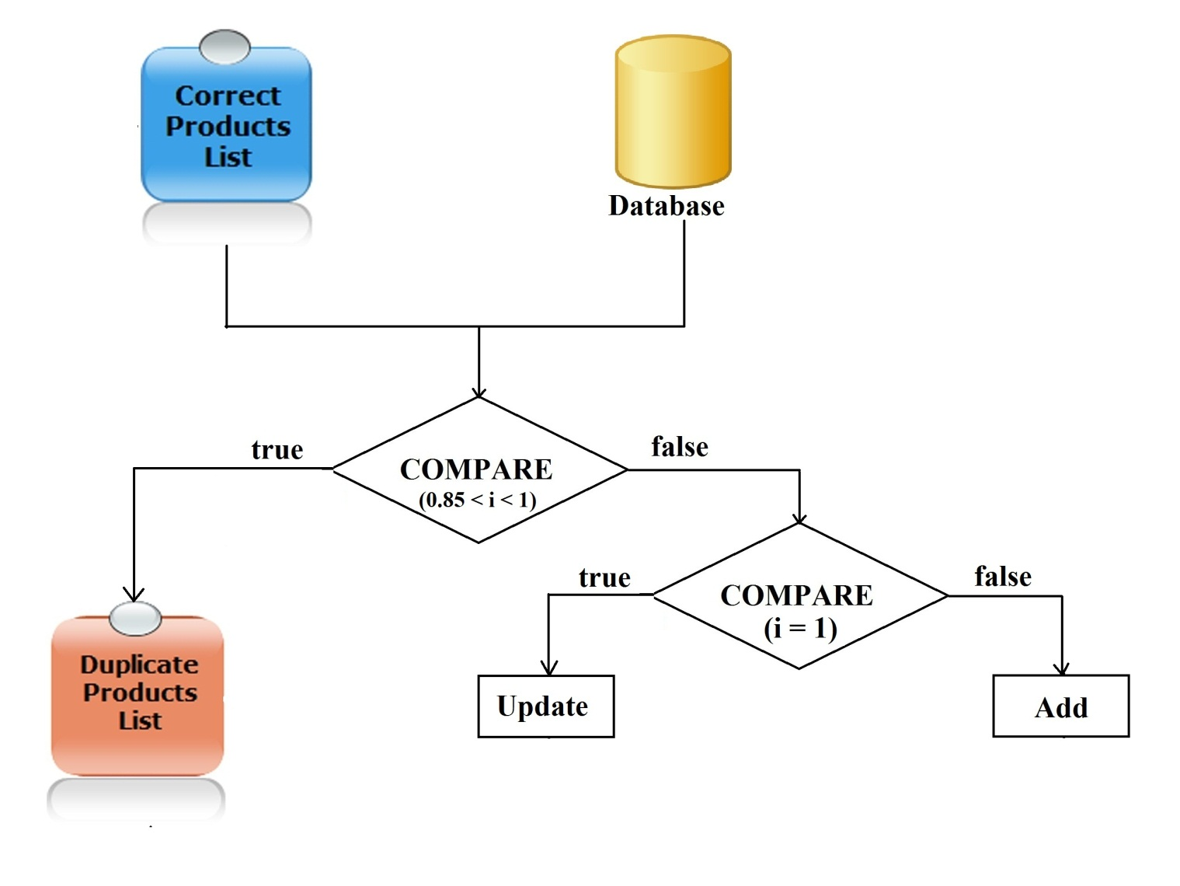
Save data to Database

Slide 8
Data mining from websites

